Slide 1


<Vincent L>
<12/18/2023>

Slide 2

Outline
Executive Summary
Introduction
Methodology
Results
Conclusion
Appendix

Slide 3
Executive Summary
Summary of methodologies
Data collection API + webscraping
Data Wrangling
Exploratory Data Analysis with SQL
Exploratory Data Analysis and Data Visualization
Interactive Visual Analytics with Folium
Machine Learning Predictive Modeling
Summary of all results
Exploratory Data Analysis results
Dashboard screenshots
Predictive Model Results

Slide 4
Introduction
Project background and context
SpaceX advertises Falcon 9 rocket launches on its website with a cost of 62 million dollars; other providers cost upwards of 165 million dollars each, much of the savings is because SpaceX can reuse the first stage. Therefore, if we can determine if the first stage will land, we can determine the cost of a launch.
Problems you want to find answers
We want to determine the price of each launch
Determine whether SpaceX will reuse the first stage of the launch
What factors determine if a rocket will land successfully in the launch and affect the success rate

Slide 5

Section 1

Slide 6
Methodology
Executive Summary
Data collection methodology:
SpaceX API and webscraping
Perform data wrangling
Used SQL and Python to create dataset,
Perform exploratory data analysis (EDA) using visualization and SQL
Perform interactive visual analytics using Folium and Plotly Dash
Perform predictive analysis using classification models
How to build, tune, evaluate classification models

Slide 7
Data Collection
Describe how data sets were collected.
Data was collected using SpaceX API and webscraping of Wikipedia using BeautifulSoup
Converted to editable pandas dataframe using .json_normalize()
Removed missing / unneeded values
Extracted launch records and converted to pandas dataframe for continued analysis and wrangling

Slide 8
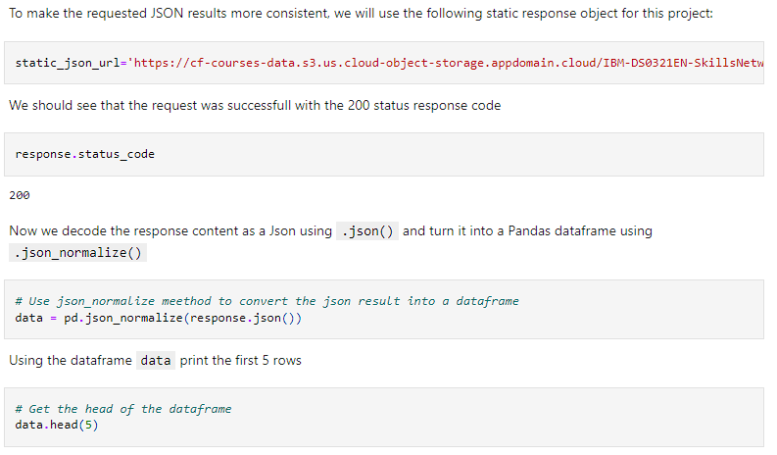
Data Collection – SpaceX API
SpaceX API get request to collect data, and used json_normalize() to clean, wrangle and format pandas dataframe
Notebook: https://github.com/vincentmliang/IBM-DS-AppliedCapstone/blob/main/1_jupyter-labs-spacex-data-collection-api.ipynb

Slide 9
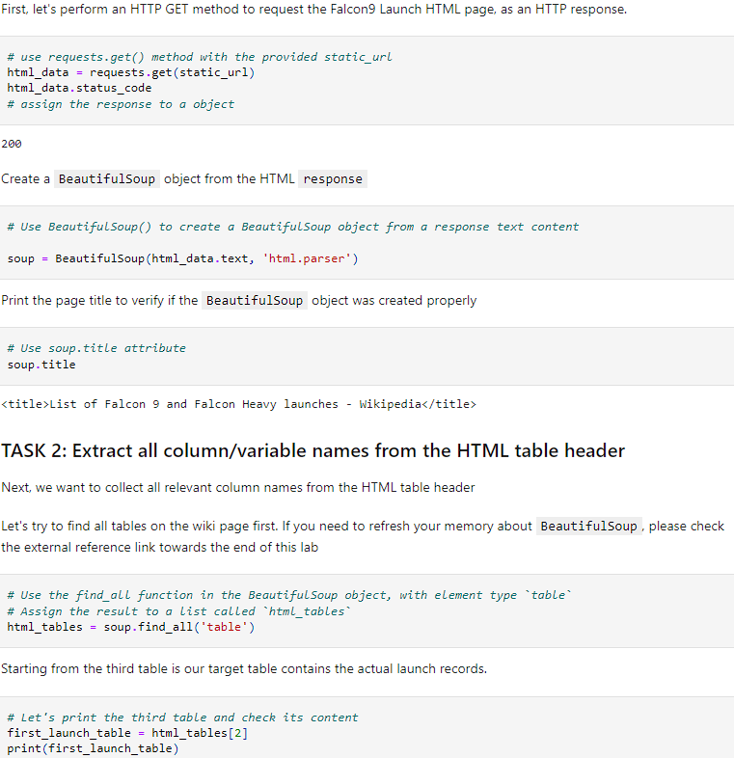
Data Collection - Scraping
Requested Falcon9 Launch Wiki using BeautifulSoup package and created editable pandas dataframe.
Notebook: https://github.com/vincentmliang/IBM-DS-AppliedCapstone/blob/main/2_jupyter-labs-webscraping.ipynb

Slide 10
Data Wrangling
Calculated exploratory data analysis in Python by calculating the number of launches on each site.
Calculated the number and occurrence of each orbit
Calculated the number and occurrences of mission outcomes of the orbits
Created a landing outcome label using an if-else statement, labeling it landing_class
Exported new dataframe to CSV file
Notebook: https://github.com/vincentmliang/IBM-DS-AppliedCapstone/blob/main/3_labs-jupyter-spacex-Data%20wrangling(1).ipynb

Slide 11
EDA with Data Visualization
Visualized relationship between flight number and launch site, payload and launch site, success rate of each orbit type, flight number and orbit type and the launch success in a yearly trend.
Notebook: https://github.com/vincentmliang/IBM-DS-AppliedCapstone/blob/main/5_jupyter-labs-eda-dataviz.ipynb.jupyterlite.ipynb

Slide 12
EDA with SQL
Used SQL queries to do exploratory data analysis and find insights on the following:
Names of unique launch sites
Total payload mass in kg carried by boosters launched by NASA
Average payload mass carried by booster version F9 V1.1
Total successful and failure mission outcomes
Failure landing outcomes in drone_ship, booster versions, and launch_site for months in year 2015.
Notebook: https://github.com/vincentmliang/IBM-DS-AppliedCapstone/blob/main/4_jupyter-labs-eda-sql-coursera_sqllite.ipynb

Slide 13
Build an Interactive Map with Folium
Using Folium, we created an interactive map marking launch sites, success or failure of launches
Using color coordinated marker clusters, you can see launch sites that have higher success rates
Using this map, you can determine where launch sites are easily and how geographical location can effect the outcome of a launch
Notebook: https://github.com/vincentmliang/IBM-DS-AppliedCapstone/blob/main/6_lab_jupyter_launch_site_location.jupyterlite.ipynb

Slide 14
Build a Dashboard with Plotly Dash
Interactive dashboard using Plotly Dash, plotting pie charts showing the total launches per site, along with scatterplot showing the relationships between outcome vs payload mass in kilograms.
This plots show relationships that may affect the outcome of certain launches.
Notebook: https://github.com/vincentmliang/IBM-DS-AppliedCapstone/blob/main/7_DashboardwPlotly

Slide 15
Predictive Analysis (Classification)
Transformed and split train and test data using train_test_split
Coded different amchine learning models and performed hyperparameter tuning using GridSearchCV
Used accuracy to metric – found best accuracy to be Decision Tree classifier
Notebook: https://github.com/vincentmliang/IBM-DS-AppliedCapstone/blob/main/SpaceX_Machine_Learning_Prediction_Part_5.jupyterlite(1).ipynb

Slide 16
Results
Exploratory data analysis results
Interactive analytics demo in screenshots
Predictive analysis results

Slide 17

Section 2

Slide 18
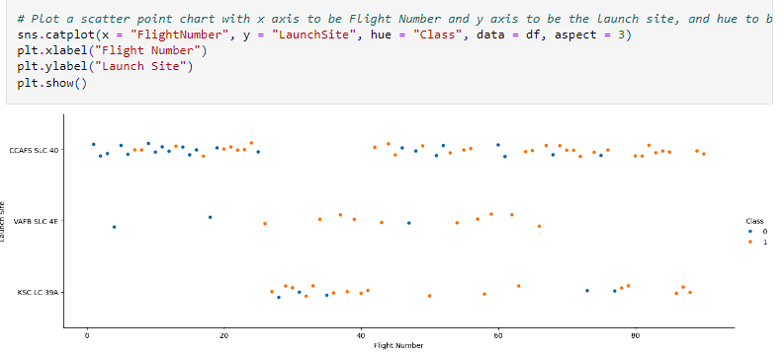
Flight Number vs. Launch Site
Flight number vs. launch site. Shows that typically, the more the launch site has more flights, the more likely / successful their launches become.
Over time, as flight numbers increase, successes (class 1) becomes more frequent

Slide 19
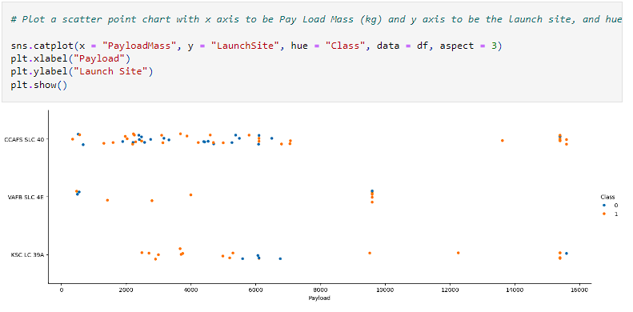
Payload vs. Launch Site
Scatterplot of payload in kilgorams vs. launch site.
Typically for launchsite CCAFS SLC 40, higher payloads at 16,000 kg had a high success rate, and mixed results from the 0-8000 kg range

Slide 20
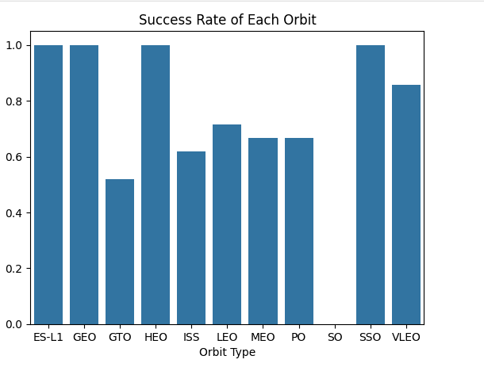
Success Rate vs. Orbit Type
Bar chart of success rates vs orbit type.
Orbit type ES-L1, GEO, HEO, and SSO had the best success rates
SO had no successful launches

Slide 21
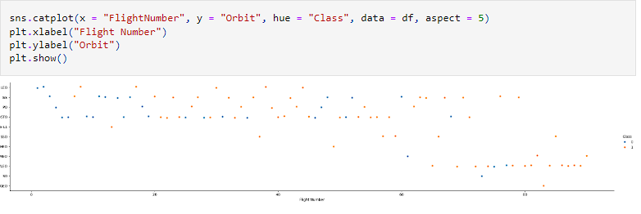
Flight Number vs. Orbit Type
Scatterplot shows flight number vs orbit type. Shows over time how each launch site goes through their successes and failures. For example, had failures in the early flight numbers, but as number of flights got higher, they became more successful
Show the screenshot of the scatter plot with explanations

Slide 22
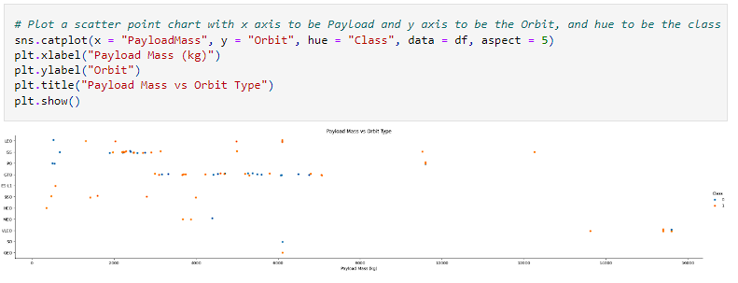
Payload vs. Orbit Type
Scatterplot of payload (kg) vs orbit type. Showcases that the heavier payloads have higher success rates, in particular for LEO, ISS and PO orbits.

Slide 23
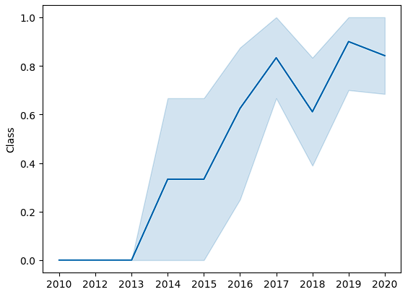
Launch Success Yearly Trend
Line chart showing the launch success yearly trend
Success rate has steadily increased over time, with a slight dip in 2017 – 2018

Slide 24
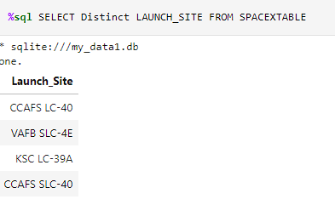
All Launch Site Names
SQL query with all launch site names. Used distinct to show only unique names from the SpaceX data
Launch site names are as follows:
CCAFS LC-40
VAFB SLC-4E
KSC LC-39A
CCAFS SLC-40

Slide 25
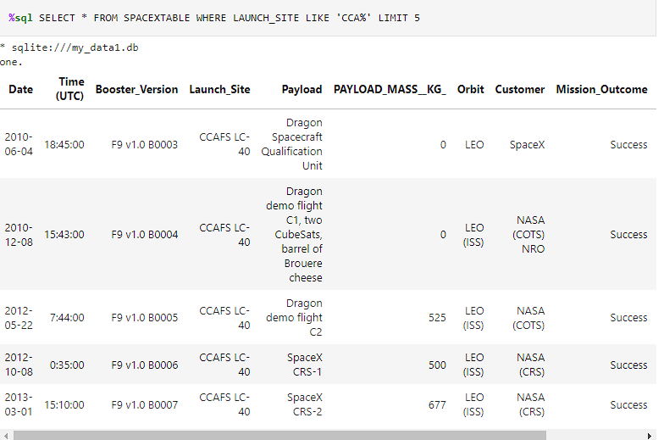
Launch Site Names Begin with 'CCA'
Find 5 records where launch sites begin with `CCA`
Used LIMIT 5 to only show the first five records where launch sites begin with ‘CCA’

Slide 26
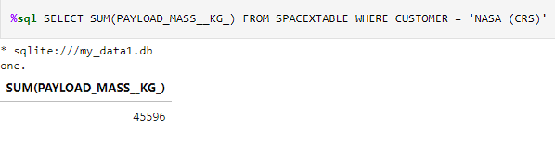
Total Payload Mass
Calculate the total payload carried by boosters from NASA
Selected the total sum of payload mass from the SpaceX Table where the customer is equal to ‘NASA (CRS)’. Total sum of all the payloads carried by boosters launched by NASA was 45,596 kg.

Slide 27
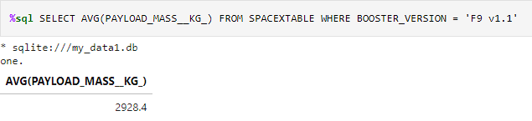
Average Payload Mass by F9 v1.1
Calculate the average payload mass carried by booster version F9 v1.1
Selected the average payload mass of booster version F9 v1.1 only. Average payload mass was 2928.4

Slide 28
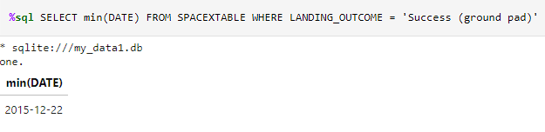
First Successful Ground Landing Date
Find the dates of the first successful landing outcome on ground pad
Selected the first date using MIN(date) to determine first successful outcome where the landing outcome was ‘Success (ground pad)’.
Result was 12/22/2015

Slide 29
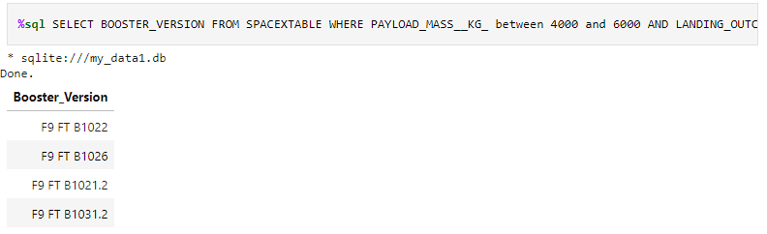
Successful Drone Ship Landing with Payload between 4000 and 6000
List the names of boosters which have successfully landed on drone ship and had payload mass greater than 4000 but less than 6000
Selected any booster versions from the SpaceX table where the payload mass was BETWEEN 4000 and 6000 AND landing outcome contained ‘Success’

Slide 30
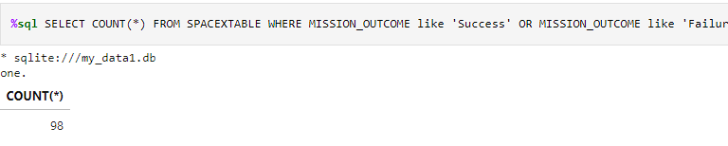
Total Number of Successful and Failure Mission Outcomes
Calculate the total number of successful and failure mission outcomes
Made a query to count all results in SpaceX table included something like ‘Success’ or ‘Failure’ in the mission outcomes column.
This counted to 98 occurrences of successful or failed mission outcomes.

Slide 31
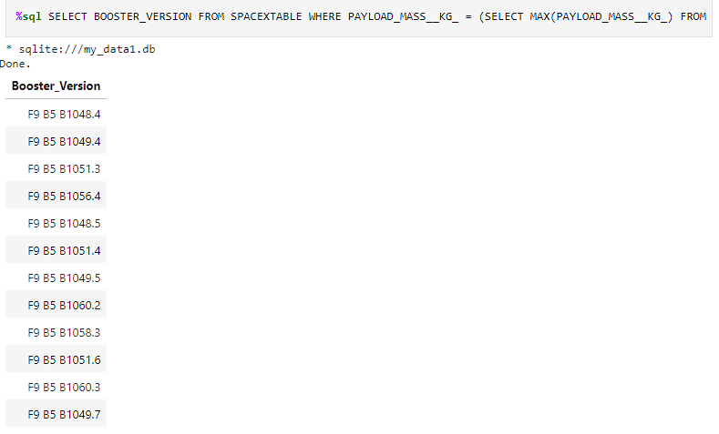
Boosters Carried Maximum Payload
List the names of the booster which have carried the maximum payload mass
Selected any booster_version from the SpaceX table where payload mass was the maximum. This lists all names of boosters that have carried maximum payload mass.

Slide 32
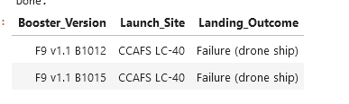
2015 Launch Records
Lists failed landing outcomes (drone ship) and puts out corresponding booster version, launch site in the year 2015.
Used BETWEEN to restrict results in 2015 year.
%sql SELECT BOOSTER_VERSION, LAUNCH_SITE, LANDING_OUTCOME FROM SPACEXTABLE WHERE LANDING_OUTCOME LIKE 'Failure (drone ship)' AND "DATE" BETWEEN '2015-01-01' AND '2015-12-31'

Slide 33
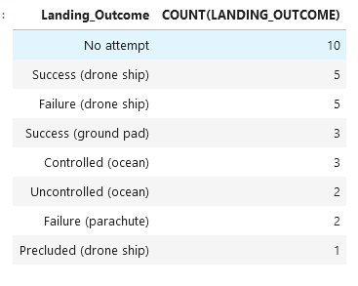
Rank Landing Outcomes Between 2010-06-04 and 2017-03-20
Ranks the landing outcomes between 2010 through 2017.
%sql SELECT LANDING_OUTCOME, COUNT(LANDING_OUTCOME) FROM SPACEXTABLE WHERE DATE BETWEEN '2010-06-04' AND '2017-03-20' GROUP BY LANDING_OUTCOME ORDER BY COUNT(LANDING_OUTCOME) DESC
Groups by the count of landing outcome in a descending order

Slide 34

Section 3

Slide 35
<Folium Map Screenshot 1>
Replace <Folium map screenshot 2> title with an appropriate title
Explore the generated folium map and make a proper screenshot to include all launch sites’ location markers on a global map
Explain the important elements and findings on the screenshot

Slide 36
<Folium Map Screenshot 2>
Replace <Folium map screenshot 2> title with an appropriate title
Explore the folium map and make a proper screenshot to show the color-labeled launch outcomes on the map
Explain the important elements and findings on the screenshot

Slide 37
<Folium Map Screenshot 3>
Replace <Folium map screenshot 3> title with an appropriate title
Explore the generated folium map and show the screenshot of a selected launch site to its proximities such as railway, highway, coastline, with distance calculated and displayed
Explain the important elements and findings on the screenshot

Slide 38

Section 4

Slide 39
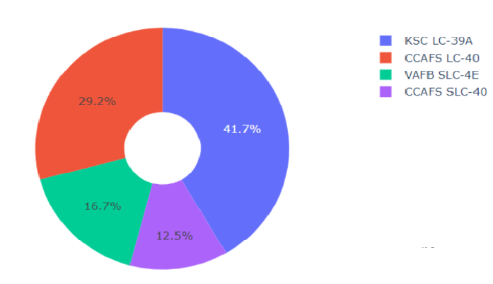
PlotlyDash Results – Sucesses per Launch Site
This dashboard result shows the percentage of successful launches per launch site. Some insights gathered is that KSC LC-39A accounts for about 41.7% of the total successful launches

Slide 40
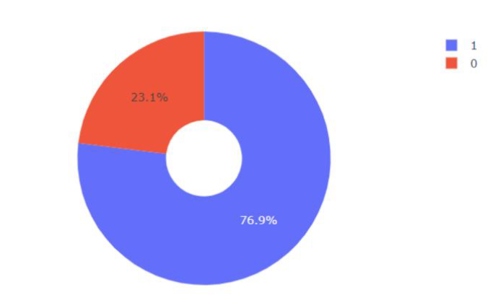
PlotlyDash Result – Success Rate KSC LC-39A
From the last slide, we gathered that launch site KSC LC-39A accounts for almost half of the successful launches. When we breakdown the success rate of that launch site, we can see they successfully launch about 77% of the time.

Slide 41
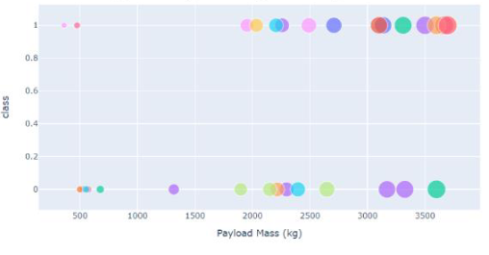
<Dashboard Screenshot 3>
Payload vs Success rate for all sites shown below. This dashboard screenshot shows the success class (0 or 1) based on the payload mass (kg).
This screenshot shows the distribution of successful launches. Here we can see that there are many successful launches around the lower end of the scale of payload mass.

Slide 42

Section 5

Slide 43
Classification Accuracy
We found that our decision tree classifier had the highest accuracy metric with 0.87 accuracy.

Slide 44
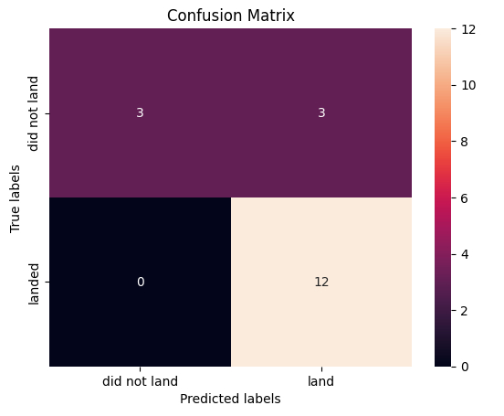
Confusion Matrix
Decision Tree classifier confusion matrix. Shows 12 True positives, 3 true negatives, and 3 false positives which unsuccessfully marked as “landed” when in reality it did not.
Overall decently good accuracy

Slide 45
Conclusions
KSC LC-39A had the highest number of successful launches, with a 77% success rate
Launch sites become more successful when having larger flight numbers/amount of launches
Launch success rate steadily increased across 2013-2020
Decision Tree Classifier was the most accurate machine learning algorithm for determining whether a launch would be successful

Slide 46


